Slide 1
AIML CA1
Loh Yip Khai(p2317454)

Slide 2
Part a
The aim of this task is to find out how different vairbale in the water will affect the water quality
The output variable I have identified is the water quality

Slide 3
Prediction Task Definition
My prediction task is defined based on looking at the variables and deciding that water quality will be the output variable
The output means whether the quality of the water is good or bad

Slide 4
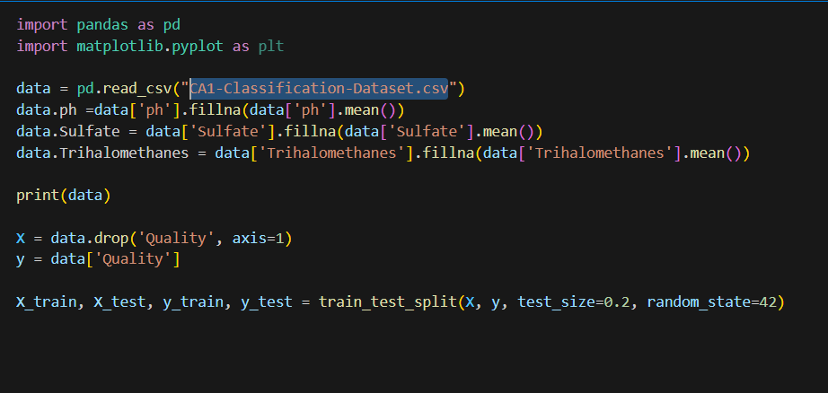
Data Overview
I used CA1-Classification-Dataset.csv, where it contained a lot of features about the water quality
I handled missing data using impute with the mean for each column

Slide 5
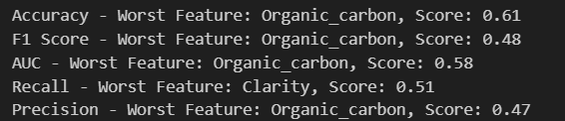
Feature Engineering
First I selected a model to be tested, in my case I used Decision Tree
Then I iterated through all of the features and dropped each feature one-by-one and rerunning the model in the end this was my results for the worst feature and the one to drop(Organic_carbon)

Slide 6
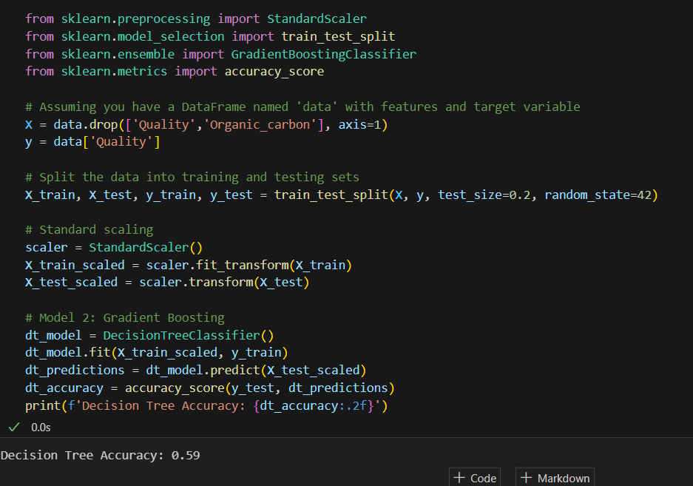
Dropping the worst feature

Slide 7
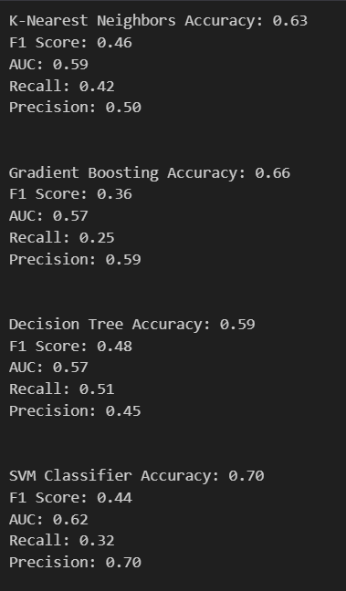
Model Selection
I selected decision tree model as I found that only after testing and tuning the the other models, decision tree produced the best results
Although it was not the best model to be chosen

Slide 8
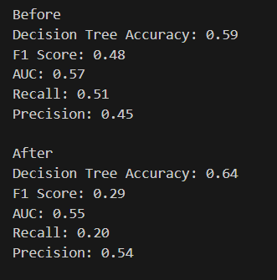
Hyperparameter Tuning
After tuning the hyperparameters. This was my observation

Slide 9
Conclusion
Overall, the accuracy increased, indicating that the model is making more correct predictions overall.
However, there is a drop in both F1 score, AUC and recall
Precision has increased, suggesting that among the instances predicted as positive, a higher proportion is true positives. However, this comes at the cost of lower recall.

Slide 10
Part b
The aim of this task is to predict how the variables given affect the hospital cost of patients admimtted
The output variable that I have identified is hospital cost

Slide 11
Dataset Overview
The key statistics about the dataset are age, gender, bmi, region and smoker status.
These non-numeric data need to be converted to numeric data using one-hot encoding

Slide 12
Feature Processing
All data seems to be given and there is not any NA or null values,
The dataset can be loaded using
data = pd.read_csv("CA1-Regression-Dataset.csv")
Dropping the cost of the dataset as it will be the output variable

Slide 13
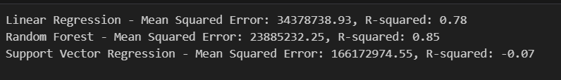
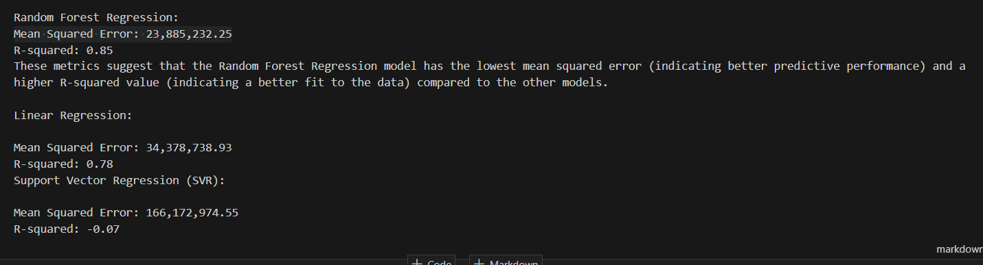
Selection of Learning Algorithms
I have selected random forest regressor based on the results of the models

Slide 14
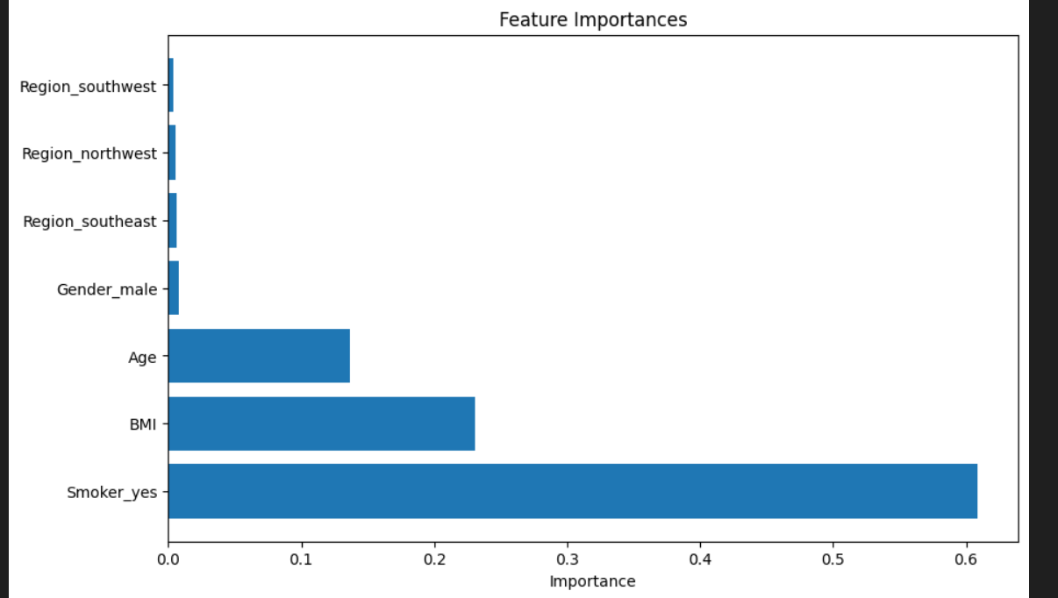
Feature Selection
From here we can see that the regions are the least important variables and can be dropped

Slide 15

Hyperparameter Tuning
After tuning the hyperparameters, we can compare the results

Slide 16
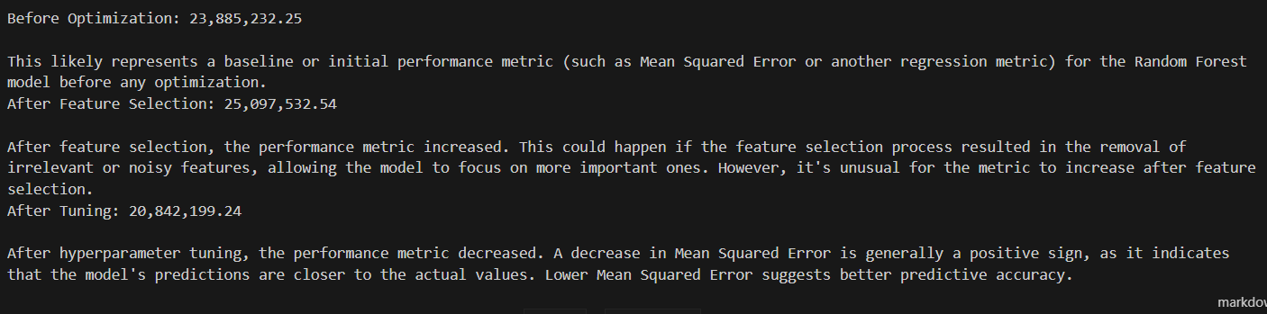
Conclusion

